Slide 1
Samsung Smartphone Recommendation System
with Revenue Analysis & Upsell/Cross-Sell Insights
Medha Vemula
MOVATE Internship | 8-Week Project | E-Commerce Domain
Week 1 – 8
Feb – Apr 2026

Slide 2
Problem Statement
Why this project matters
"The company is not effectively identifying and targeting existing customers for upsell and cross-sell opportunities, resulting in lost revenue potential."
Lost Revenue
No Personalisation
No Data-Driven CRM
Missed upsell/cross-sell opportunities with existing customers
Customers receive generic offers not tailored to their needs
Absence of analytics to identify high-value customer segments

Slide 3
Objective
Goals of the 8-week internship project
01
Understand the Problem
02
Data Collection & EDA
Deep-dive into upsell & cross-sell concepts; study Amazon, SaaS, and telecom examples
Collect, clean, and analyze customer datasets; identify purchase patterns and segments
03
Build Recommendation Engine
04
Revenue & ROI Estimation
Apply Apriori algorithm to mine association rules and build a smart recommendation framework
Estimate revenue impact, calculate ROI, and evaluate business effectiveness of recommendations

Slide 4
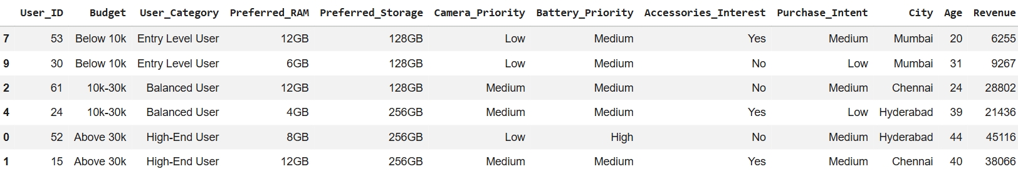
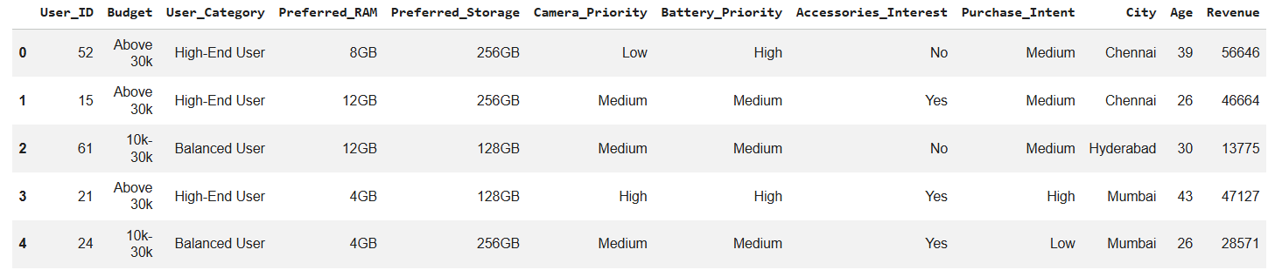
Dataset Overview
Source: Kaggle-inspired structured dataset | Domain: Smartphone E-Commerce
📋 Dataset Sample :
User_ID | Budget | User_Category | Pref_RAM | Pref_Storage | Camera | Battery | City | Age | Revenue (₹)
52 | Above 30k | High-End User | 8GB | 256GB | Low | High | Chennai | 35 | 51,033
15 | Above 30k | High-End User | 12GB | 256GB | Medium | Medium | Bangalore | 39 | 57,199
61 | 10k–30k | Balanced User | 12GB | 128GB | Medium | Medium | Chennai | 33 | 24,784
21 | Above 30k | High-End User | 4GB | 128GB | High | High | Hyderabad | 28 | 45,551
500+ Records
10 Features
3 Segments
3 Cities
Customer dataset
Budget , RAM, Camera , Age , City…
Entry / Balanced / High-End
Mumbai • Hyderabad • Bangalore
✅ Dataset includes features such as Age, City, Revenue, and customer preferences for recommendation and business analysis.

Slide 5
System Architecture
End-to-end pipeline: from raw data to business recommendations
Raw Data
Pre-
processing
Apriori
Algorithm
Association
Rules
Recommendation
Engine
Revenue
ROI
Insights/Dashboard
(Streamlit)
1
2
3
4
5
6
7
Data Layer
Algorithm Layer
Recommendation Layer
Business Layer
Samsung smartphone dataset(inspired from Kaggle) • 500+ records • 10 attributes • 3 cities
Apriori with min_support=0.05 • Confidence threshold=0.5 • Lift > 1 filter
Upsell (device upgrade) • Cross-sell (accessories) • Downgrade (budget-based alternative)
Revenue estimation • ROI calculation • User-Segment analysis • City-wise contribution

Slide 6
Methodology
Week-by-week approach to solving the upsell/cross-sell problem
Wk 1–2
Problem & Data
Wk 3–4
Survey Design
Wk 5
EDA & Clustering
Studied upsell/cross-sell concepts. Selected smartphone domain. Loaded Mobilephones 500-record dataset from Kaggle and flitered Samsung brand from the dataset
Designed structured survey with questions on product usage, satisfaction, awareness & willingness. Deployed via Google Forms & collected
Data.
Analysed purchase patterns. Segmented users into Entry, Balanced, High-End. Identified demographic categories.
Wk 6
Apriori Algorithm
Wk 7
Strategy & ROI
Wk 8
Final Delivery
Applied Apriori mining. Generated 9 top association rules with confidence=1.0, lift=1.98. Identified perfect rules.
Estimated revenue impact per segment. Built ROI model showing 873% return.
Compiled full report + PPT + Streamlit dashboard demo showcasing recommendation engine live.

Slide 7
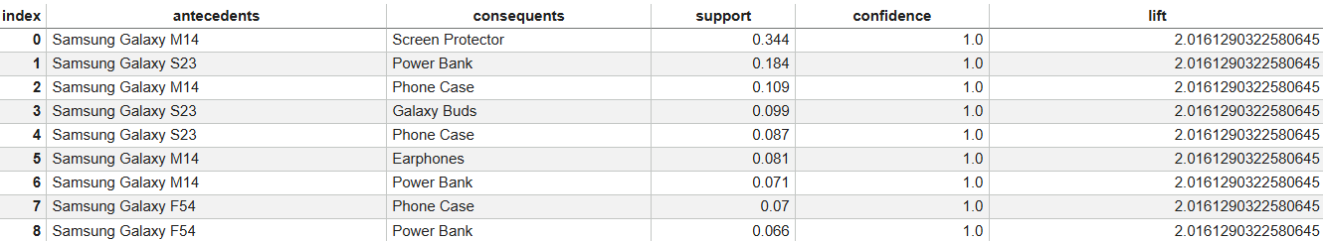
Association Rules (Apriori Algorithm)
Week 6 deliverable — mining rules from Samsung transaction data
Support
Confidence
Lift
freq(A∪B) / N
P(B | A)
Conf / P(B)
How often items appear together in transactions
Probability of buying B given customer bought A
Strength of rule vs random chance. Lift > 1 = meaningful
🔍 Top Association Rules – Output from Week 6 Code
Antecedent (If…) | Consequent (…then) | Support | Confidence | Lift
Samsung Galaxy M14 | Screen Protector | 0.353 | 1.0 | 1.980
Samsung Galaxy M14 | Wireless Charger | 0.163 | 1.0 | 1.980
Samsung Galaxy S23 | Phone Case | 0.184 | 1.0 | 1.980
Samsung Galaxy F54 | Phone Case | 0.081 | 1.0 | 1.980
Samsung Galaxy M14 | Power Bank | 0.124 | 1.0 | 1.980
All top rules show Confidence = 1.0 (perfect rules) — every customer buying A always buys B

Slide 8
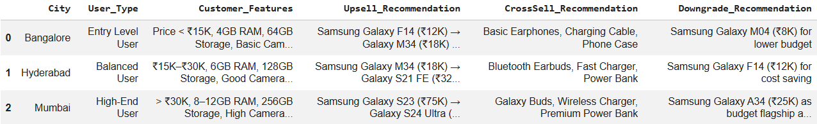
Smart Recommendation System
Upsell · Cross-Sell · Downgrade logic by user segment & city
⬆ UPSELL
↔ CROSS-SELL
⬇ DOWNGRADE
Suggest premium device upgrades.
Entry → Galaxy M34 (₹18K)
Balanced → Galaxy S21 FE (₹32K)
High-End → Galaxy S24 Ultra (₹1.2L)
Paired accessories from rules:
Basic Earphones, Charging Cable
Bluetooth Earbuds, Fast Charger
Galaxy Buds, Power Bank
Budget-friendly alternatives:
Galaxy M04 (₹8K) for Entry
Galaxy F14 (₹12K) for Balanced
Galaxy A34 (₹25K) for High-End

Slide 9
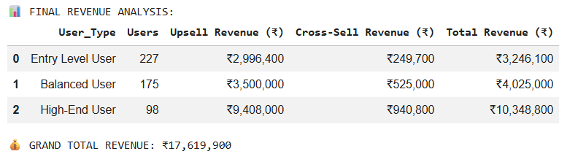
ROI Analysis
Revenue breakdown by user segment & city | Business impact estimation
₹1.76 Cr
873%
₹1.57 Cr
₹18 L
Grand Total Revenue
Return on Investment
Net Profit
Total Cost
User Category | Users | Upsell Rev (₹) | Cross-Sell (₹) | Total Rev (₹)
Entry Level User | 227 | 29,96,400 | 2,49,700 | 32,46,100
Balanced User | 175 | 35,00,000 | 5,25,000 | 40,25,000
High-End User | 98 | 94,08,000 | 9,40,800 | 1,03,48,800
City-wise Revenue Share
Mumbai 58.73%
Hyderabad 22.84%
Bangalore 18.43%
Cost Breakdown:
Marketing ₹5L + Operational ₹3L + Variable ₹10L = Total Cost ₹18L | Depreciation (10%) = ₹1L | Net Profit = ₹1.57Cr

Slide 10
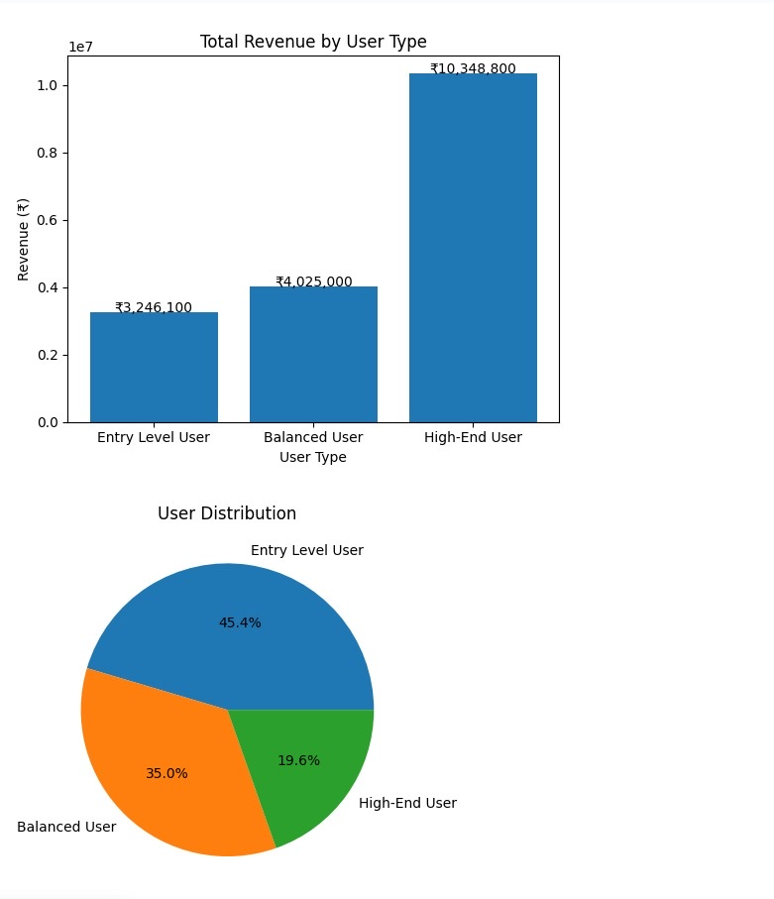
Revenue Charts
Total Revenue by User Type | User Distribution

Slide 11
Results
Key findings from EDA, Apriori mining & revenue analysis
📱 High-End Users = Highest Revenue
🔗 Perfect Association Rules Found
Just 19.6% of users (98 High-End Users) generate 58.73% of total revenue (₹1.03 Cr). Prioritise this segment.
9 rules with confidence=1.0 identified. Galaxy M14 buyers always purchase Screen Protector, Phone Case.
📍 Mumbai Leads in Revenue
🎯 Cross-Sell Adds ~10% Revenue
Mumbai contributes 58.73% of city-wise revenue, followed by Hyderabad (22.84%) and Bangalore (18.42%).
Phone Cases (348 units) and Screen Protectors (297 units) are most purchased accessories. High cross-sell potential.
💰 ROI = 873%
📊 Balanced Users: Mid-Tier Opportunity
Total revenue ₹1.76 Cr against cost of ₹18L yields net profit of ₹1.57 Cr — a highly positive business case.
175 Balanced Users generate ₹40.25L. Targeted upsell campaigns can shift them to the High-End segment.

Slide 12
Challenges
Limitations encountered during the 8-week project
01
Static Dataset
02
Strict Rule Thresholds
Dataset was synthetically expanded and doesn't reflect live customer behavior or seasonal trends.
Apriori requires min_support tuning. Very low support generated noise; high thresholds missed rare patterns.
03
Limited Survey Sample
04
UI / Dashboard Scope
Survey responses were limited to peers/public — not a representative sample of real Movate customers.
Streamlit dashboard is basic. Production-grade UI requires advanced front-end integration with CRM systems.

Slide 13
Future Scope
Enhancements to evolve the system into a production-ready solution
🤖
📡
🎨
ML-Powered Predictions
Real-Time Data Pipeline
Personalisation Engine
Replace rule-based logic with collaborative filtering or XGBoost to personalise recommendations at scale.
Integrate live transaction streams via Kafka or APIs to update recommendations dynamically.
Incorporate browsing history, wish-list data, and demographics for hyper-personalised offers.
💲
🔗
📊
Dynamic Pricing Module
CRM Integration
Advanced Dashboard
Introduce price elasticity models to offer optimal discounts that maximise conversion and margin.
Connect output to Salesforce/HubSpot to trigger automated campaigns based on model outputs.
Build interactive Power BI / Streamlit dashboard with real-time KPI tracking and drill-down analytics.

Slide 14
Conclusion
Built an end-to-end Smart Recommendation System using Apriori association rule mining on a 500+ record smartphone dataset
Identified 9 perfect association rules (confidence=1.0) that directly drive cross-sell accessory recommendations
Estimated ₹1.76 Cr in total revenue with 873% ROI, confirming the strong business case for upsell/cross-sell targeting
Segmented customers into 3 groups — High-End Users (₹1.03 Cr, 58.7%) emerge as the most valuable segment
Delivered a recommendation framework, ROI model, and Streamlit dashboard ready for business deployment
THANK YOU..
Medha Vemula • MOVATE Internship • vemulamedha@gmail.com

